Slide 1


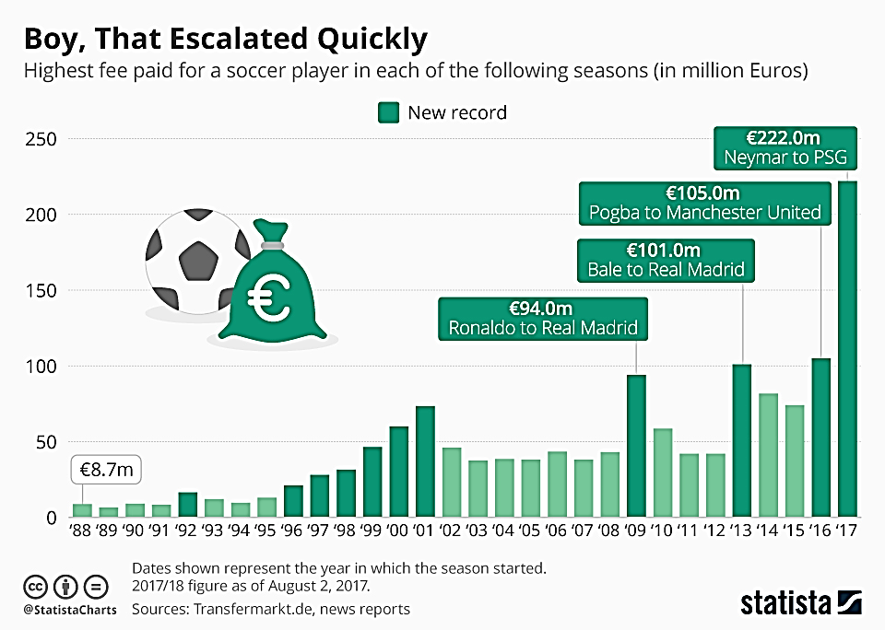
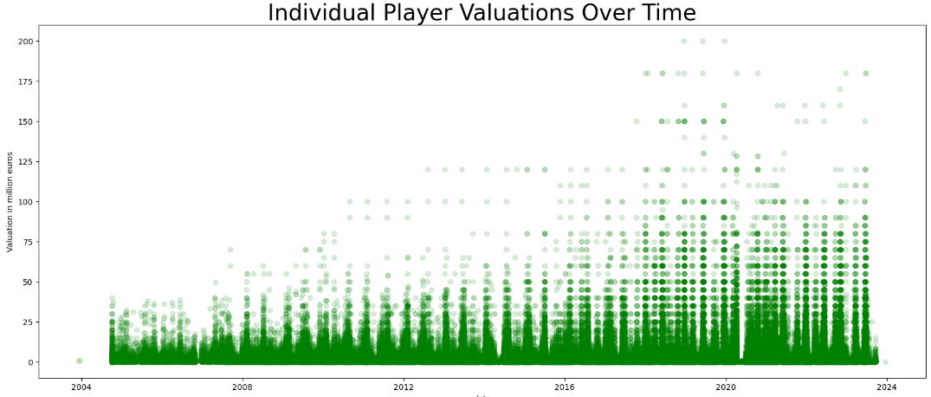
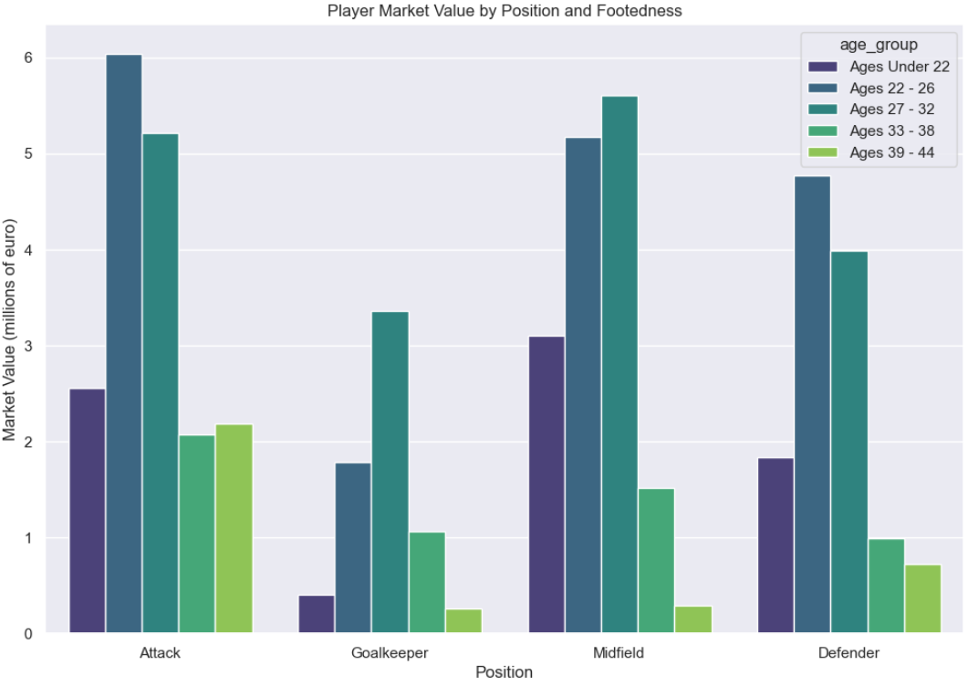
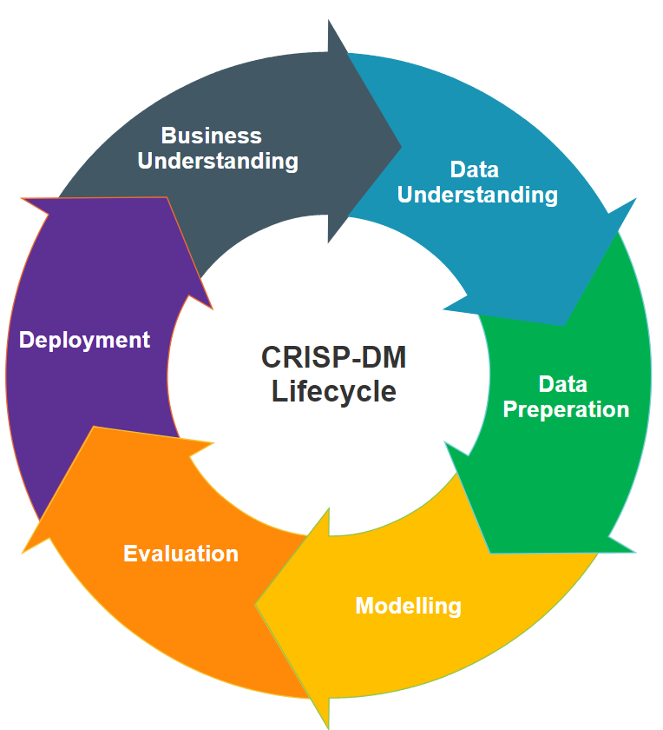

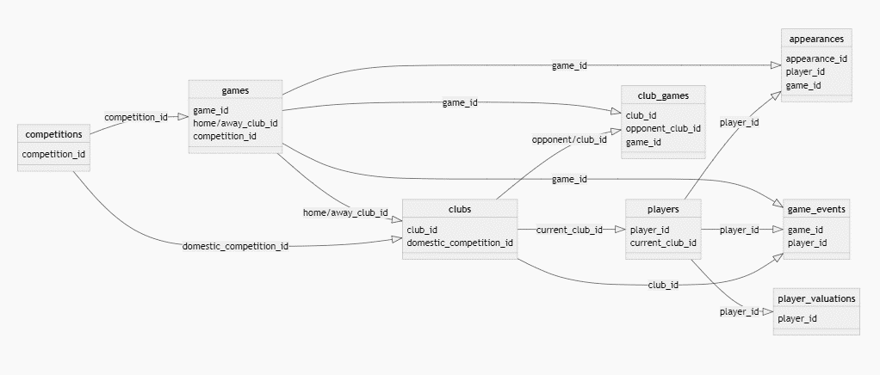
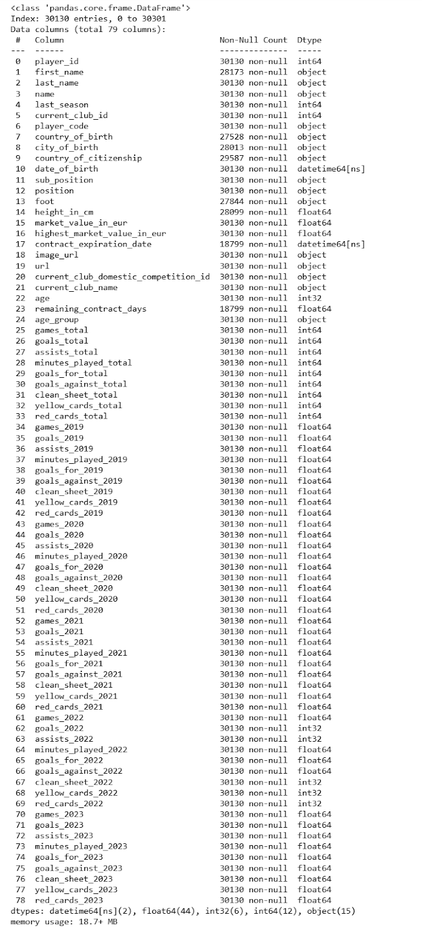
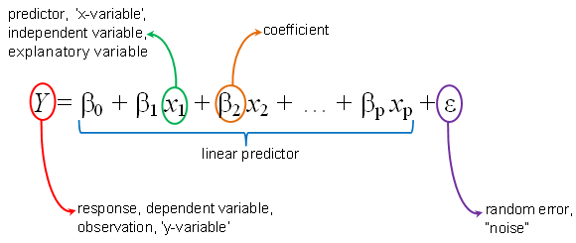
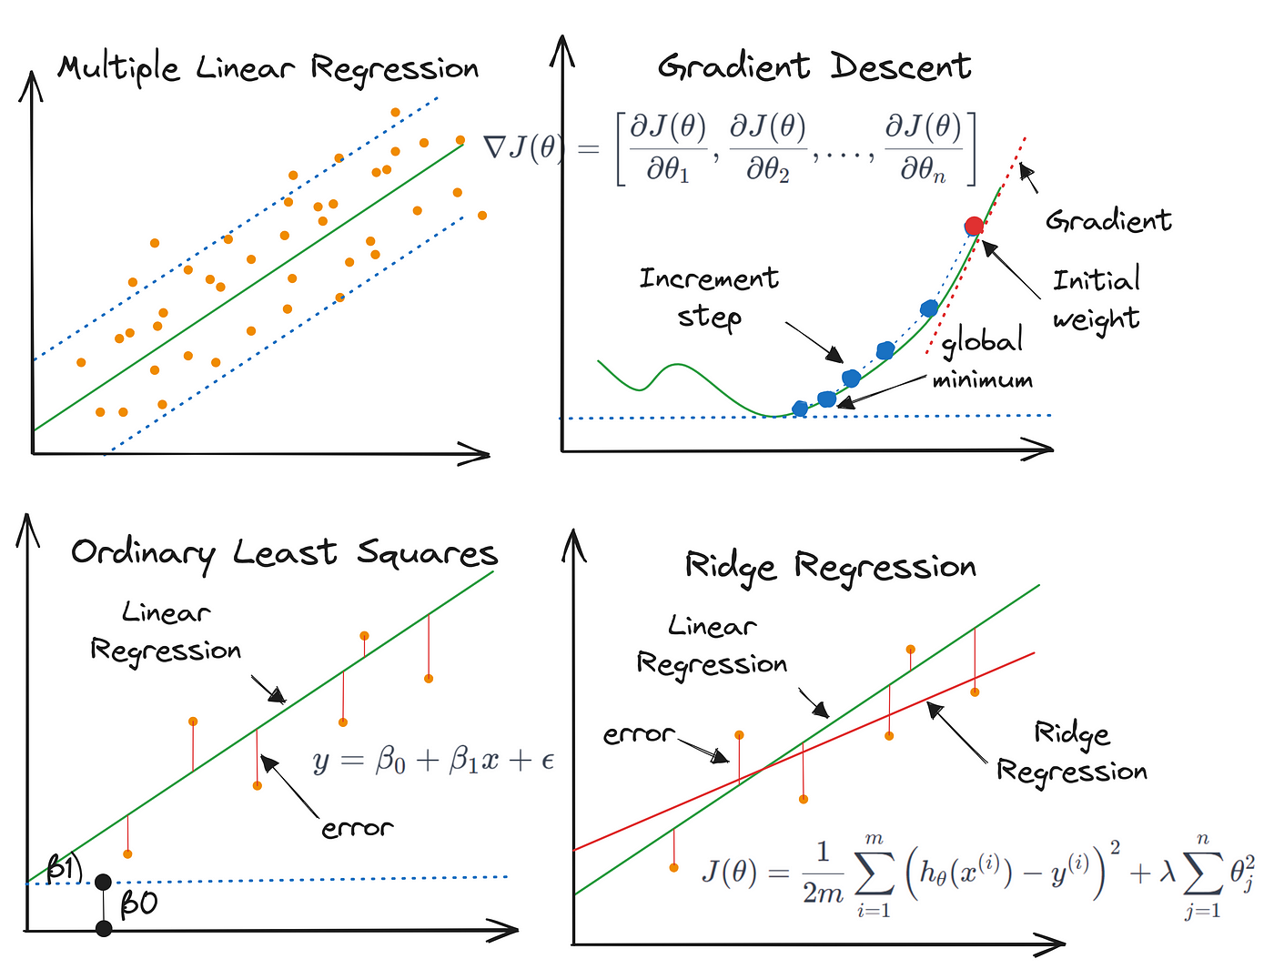
Leveraging Machine Learning and Data Science for Competitive Advantage: Estimating Football Player Market Values
Author: Kavi Patak Lecturer: James Garza
Introduction
2. Exploratory Data Analytics
The role of analytics in football has evolved over the past decade, and will continue to do so. Technological developments continue to improve the volume and quality of data available to the world’s leading clubs, as well as the ability to derive insight from them. The opportunity exists for clubs of all sizes to use analytics to build a sustainable competitive advantage, something which will be most evident in the area where they invest most: the transfer market.
The Process…
Business Understanding
3. Preprocessing
The role of analytics in football has evolved over the past decade, and will continue to do so. Technological developments continue to improve the volume and quality of data available to the world’s leading clubs, as well as the ability to derive insight from them. The opportunity exists for clubs of all sizes to use analytics to build a sustainable competitive advantage, something which will be most evident in the area where they invest most: the transfer market.
The role of analytics in football has evolved over the past decade, and will continue to do so. Technological developments continue to improve the volume and quality of data available to the world’s leading clubs, as well as the ability to derive insight from them. The opportunity exists for clubs of all sizes to use analytics to build a sustainable competitive advantage, something which will be most evident in the area where they invest most: the transfer market.
Evaluation
Data Understanding
1. Merging and Characterising the Data
Modelling
Data: “Football Data from Transfermarkt” provided by Kaggle
Available at: https://www.kaggle.com/datasets/davidcariboo/player-scores/versions/284
9 CSV Files
appearances_df : (1485697, 13)
club_games_df : (128586, 11)
clubs_df: (426, 16)
competitions_df: (43, 10)
game_events_df: (652010, 10)
game_lineups_df : (86822, 9)
games_df : (64293, 23)
player_valuations_df : (440663, 9)
players_df: (30302, 23)
Deployment
The Combined
Conclusion
References

Slide 2
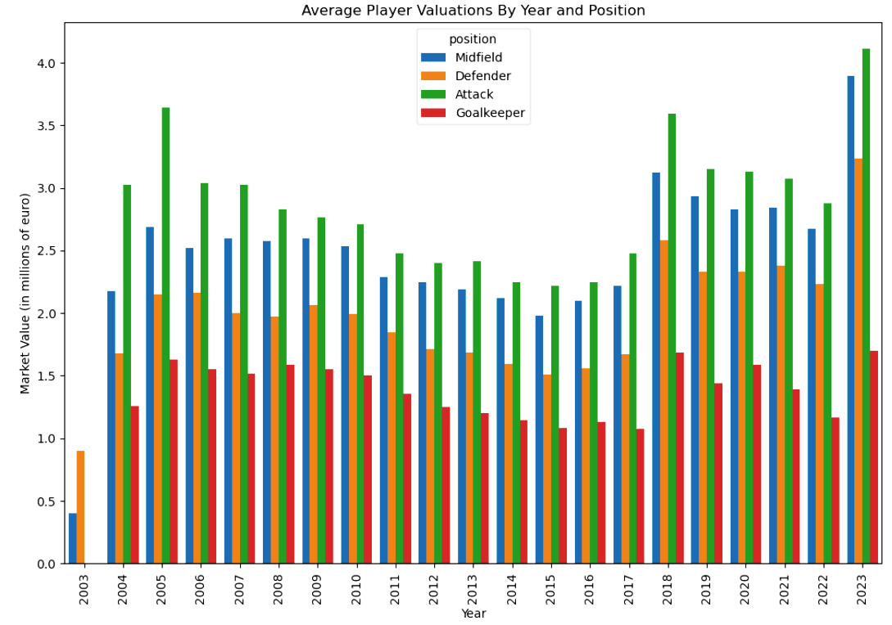
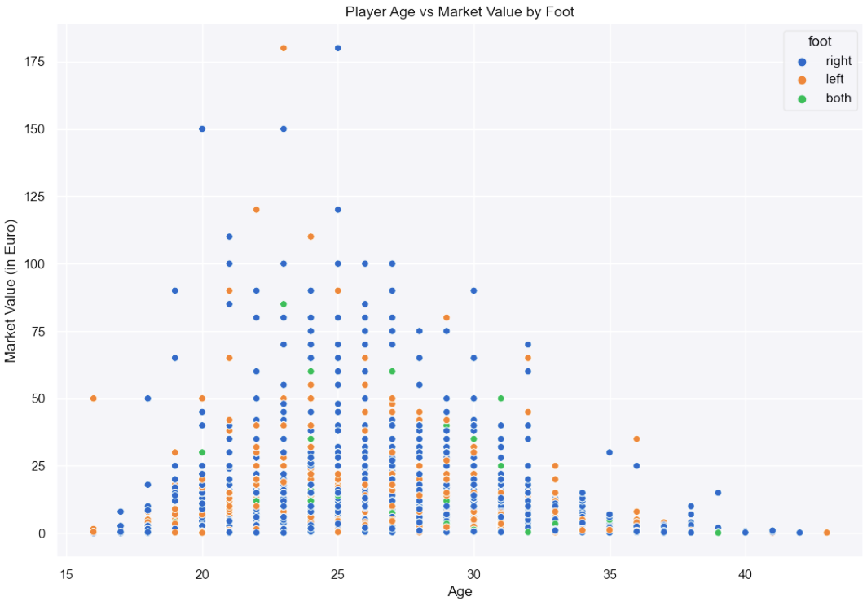
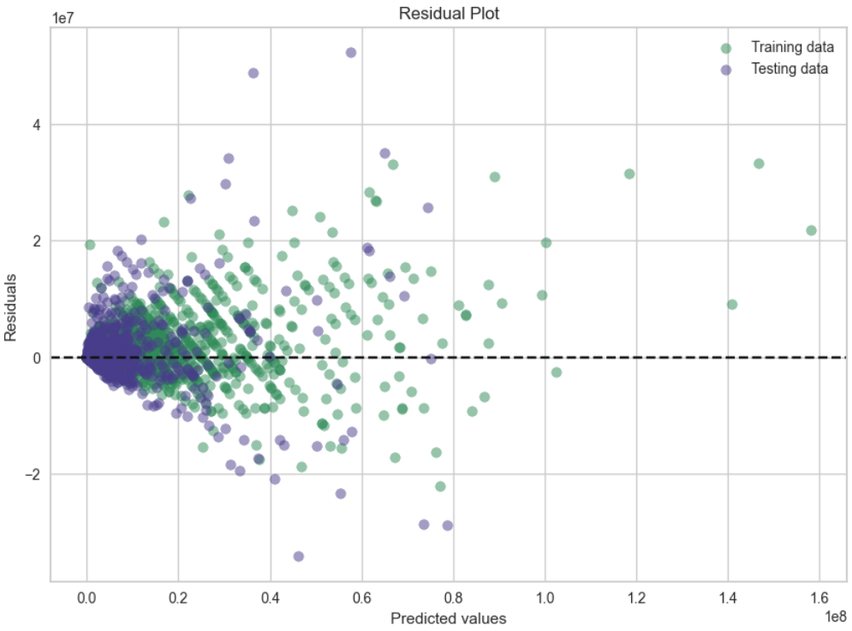
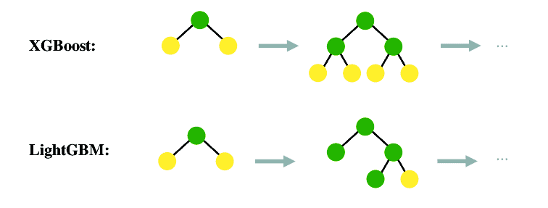
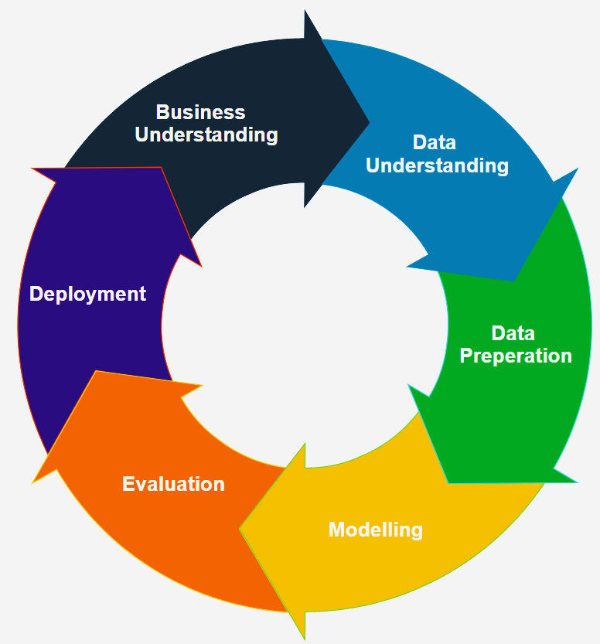
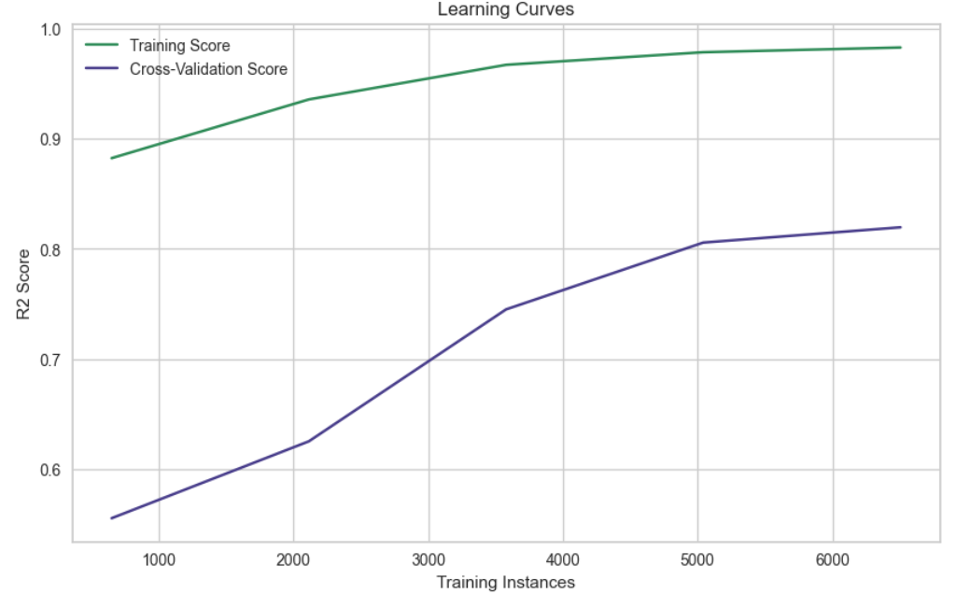
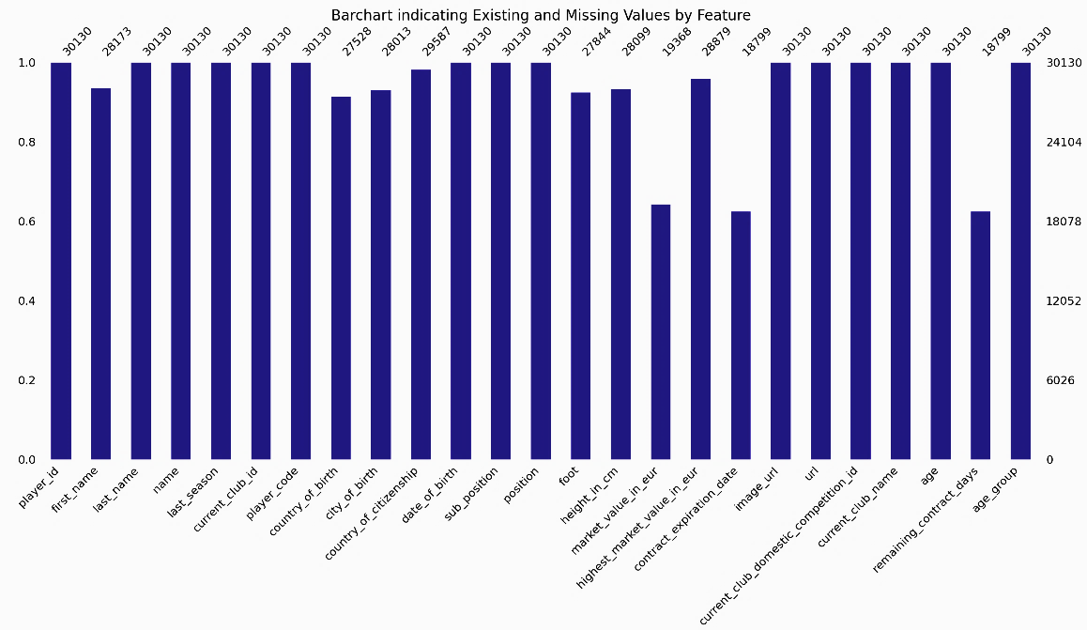

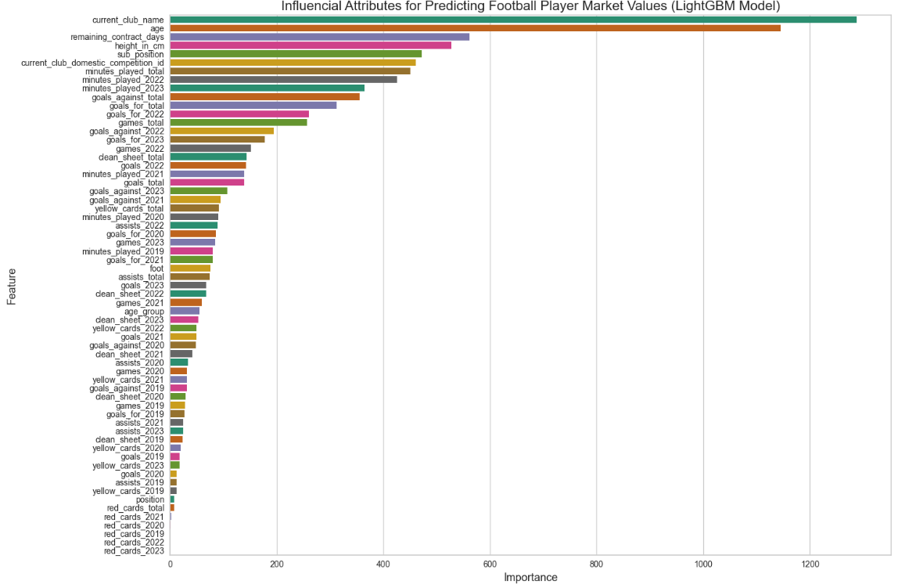
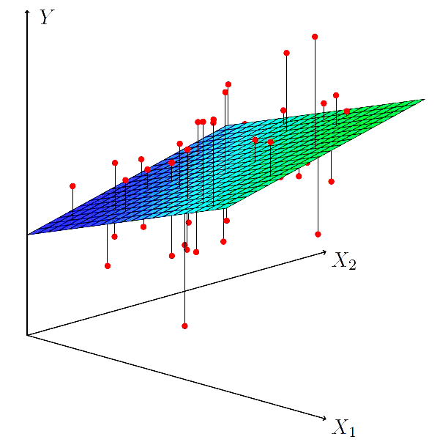
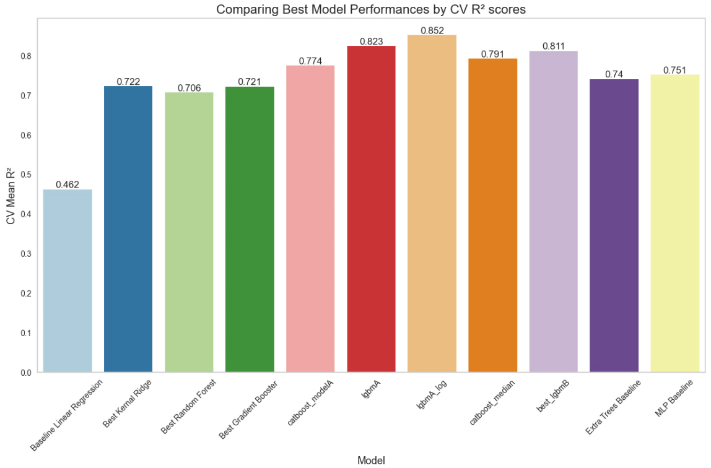
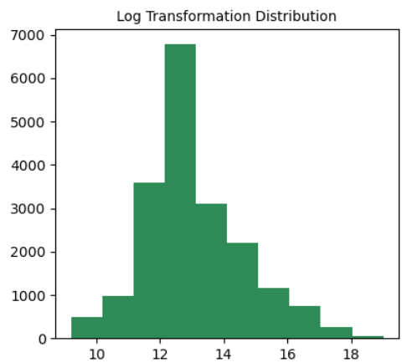
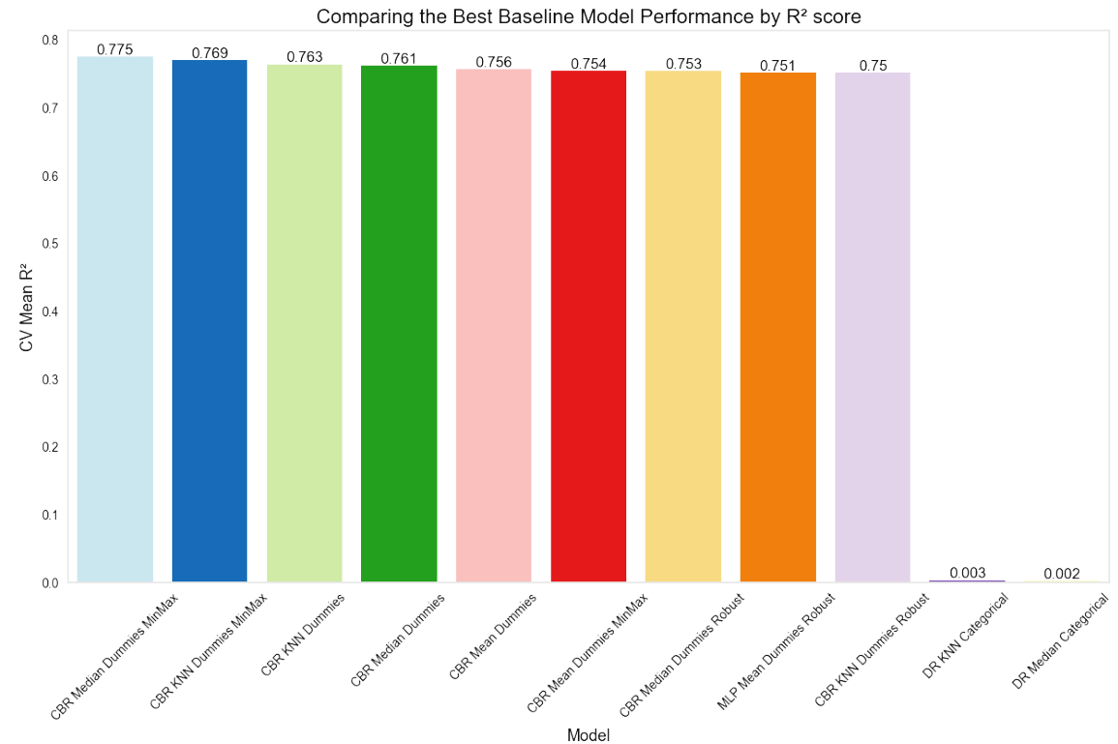
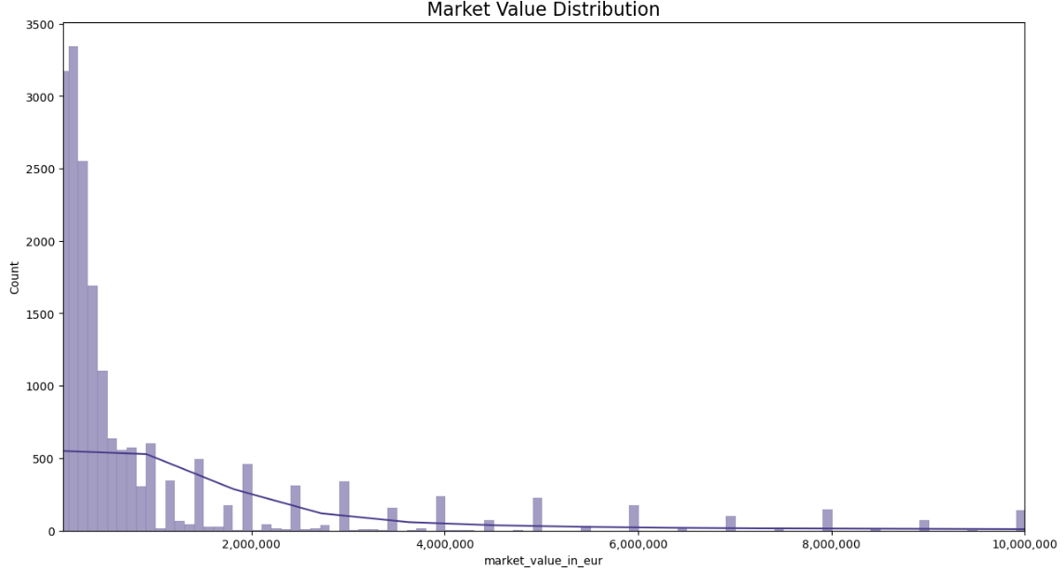
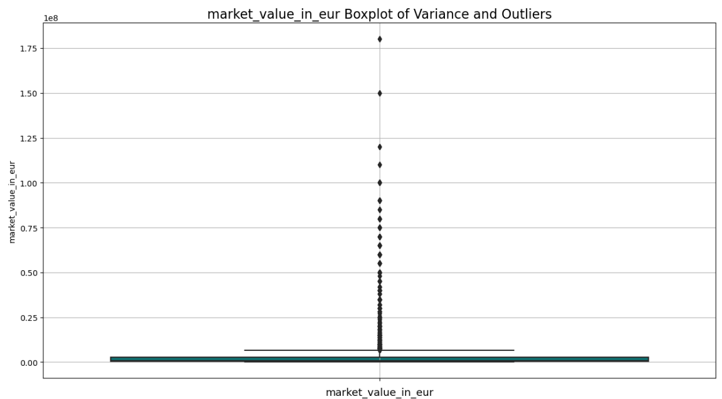
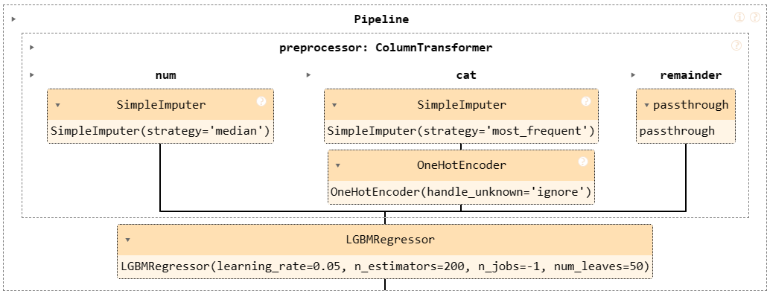












Leveraging Machine Learning and Data Science for Competitive Advantage: Estimating Football Player Market Values
Author: Kavi Patak Supervisor: James Garza
Introduction
Multivariate Analysis
The best model developed for predicting a football player’s market value with the available data is LightGBM. LightGBM is a gradient-boosting framework that uses tree-based learning algorithms.
The role of analytics in football has evolved over the past decade, and will continue to do so. Technological developments continue to improve the volume and quality of data available to the world’s leading clubs, as well as the ability to derive insight from them. The opportunity exists for clubs of all sizes to use analytics to build a sustainable competitive advantage, something which will be most evident in the area where they invest most: the transfer market.
It adopts a leaf-wise growth strategy, as opposed to the traditional level-wise approach. The fundamental difference lies in how the tree grows and how
branches expand.
The tree grows by adding a leaf that provides the maximum gain at each expansion step. In other words, only one leaf node is added at each expansion step.
The Methodology…
Traditional Models
1. Business Understanding
This initial phase focuses on understanding the project objectives and requirements from a business perspective.
Light GBM
3. Data Preparation
5. Evaluation
Football is a highly lucrative sport that depends heavily on the services of football players. It is therefore no surprise that the majority of a club's expenditure is on player transfers and wages, with smaller clubs unable to compete financially with their larger counterparts.
Preprocessing
Evaluating The Model
Data preparation and preprocessing is a crucial step in any Data Science project’s lifecycle. It involves several operations and transformations being applied to raw data to make it suitable for analysis and modelling.
From the residuals plot we find that the model appears to predict well for lower market values, densely located around the origin.
Promisingly, there appears to be a normal distribution of error predictions about the origin line.
The learning curves indicate an overfitting model, determinable by the lower test scores (purple line) relative to the high training scores.
This project aims to level the playing field, at least financially in the transfer market, by developing a machine learning (ML) model to estimate the market value of football players based on various features such as age, goals, assists and other contributing factors.
CRISP-DM
Lifecycle
The aim is to enhance the quality of the data by:
addressing missing or inconsistent values,
Consolidating and Characterising the Data
2. Data Understanding
handling various data types including type casting,
In this phase, we gather and understand the data required for the project. This includes identifying data sources, collating data, and exploring its structure, validity, and content. A large dataset Is sourced from Kaggle, and its suitability confirmed.
number formatting, and label encoding categorical variables,
Promisingly, the learning curves suggest further improvements with more data.
transforming or scaling the data using standardisation or normalisation techniques,
Evaluating Results
Data: “Football Data from Transfermarkt” provided by Kaggle
After building models, they need to be evaluated to determine their performance and effectiveness.
Available at: https://www.kaggle.com/datasets/davidcariboo/player-scores/versions/284
9 CSV Files:
Merged Dataset
and conducting feature engineering.
For regression problems, Sklean provides multiple metrics including Mean Absolute Error (MAE), Mean Squared Error (MSE), Root Mean Squared Error (RMSE), and R-squared (R²) for more advanced metrics, with R² being more intuitive, and the preferred choice.
appearances_df : (1485697, 13)
club_games_df : (128586, 11)
clubs_df: (426, 16)
competitions_df: (43, 10)
game_events_df: (652010, 10)
game_lineups_df : (86822, 9)
games_df : (64293, 23)
player_valuations_df : (440663, 9)
players_df: (30302, 23)
Multiple datasets are created based on different preprocessing and imputation techniques.
4. Modelling
The model achieves a CV Mean R² score of 0.823 which increases to 0.852 when optimised and trained on the log transformation of the target variable.
In this phase, we build and evaluate models to address the project objectives. This involves selecting appropriate modelling techniques, applying appropriate train : test splits, building different models, and adjusting their parameters through hyperparameter tuning before cross-validating (CV) the results.
In comparison to the baseline LR model, we have achieved an 84.5% improvement.
Exploratory Data Analytics (EDA)
EDA is a process of examining the available data to discover patterns of correlation, identify trends, and gain insights of interest. It aids in spotting anomalies, testing hypotheses and clarifying any assumptions.
The objective is to predict the market value of a player, which is continuous data, using multiple predictors, making this a multiple regression problem.
Furthermore, we are using labelled data making this a supervised ML application.
Simple Linear Regression is a statistical model which estimates the linear relationship between two variables.
Multiple Regression is the analysis between the relationships between a single dependent variable and several independent variables.
6. Deployment
The Deployment phase within the CRISP-DM methodology involves implementing the solutions derived from modelling into practical use.
This includes integrating them with existing systems, providing documentation, and offering support to end-users to derive business value. Although perhaps premature, a pipeline of the model has been generated.
We find that the target variable data, ‘Market Value’, is right skewed, and requires a log transformation for normal distribution. The data also contains multiple outliers, identifiable through dots in the box plot below.
Through EDA we discover similar patterns and irregularities within the independent variables used for predicting. These findings will influence preprocessing decisions and techniques applied in Machine Learning.
Conclusion
Bivariate Analysis
Over 25 baseline models are tested on default parameters with the most promising selected for optimisation.
Models selected for optimisation:
Kernel Ridge Regressor (KN)
Random Forest Regressor (RFR)
Gradient Boosting Regressor (GBR)
Categorical Boost Regressor (CBR)
Light Gradient Boosting Machine (LGBM)
Player scouting and market value analysis are key areas where ML can provide valuable knowledge and insights to the football industry. This capstone project aims to contribute to this, by empowering clubs and stakeholders with data-driven decision-making capabilities, for a competitive advantage.
At the end of the process, the results are positive but
the project still provides plenty of scope for improvement.
The exact degree of success may only be determined by domain experts and per application.
Technologies...
References…
Wirth, R. and Hipp, J. (2000). CRISP-DM: Towards a Standard Process Model for Data Mining . Proceedings of the 4th international conference on the practical applications of knowledge discovery and data mining, (Vol. 1, pp. 29-39).
Müller, A.C. and Guido, S. (2017). Introduction to machine learning with Python : a guide for data scientists. Beijing: O’reilly.
Technology, T. (2023). Light GBM Light and Powerful Gradient Boost Algorithm. [online] Medium.
Available at: https://medium.com/@turkishtechnology/light-gbm-light-and-powerful-gradient-boost-algorithm-eaa1e804eca8.

Slide 3
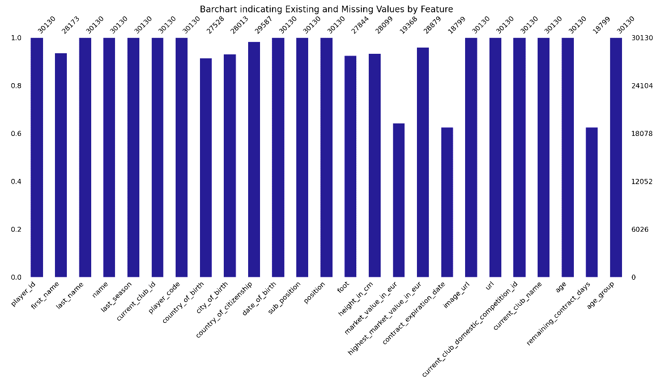

Leveraging Machine Learning and Data Science for Competitive Advantage: Estimating Football Player Market Values
Author: Kavi Patak Supervisor: James Garza
Introduction
Multivariate Analysis
LightGBM adopts a leaf-wise growth strategy, as opposed to the traditional level-wise approach. The fundamental difference lies in how the tree grows and how branches expand.
The role of analytics in football has evolved over the past decade, and will continue to do so. Technological developments continue to improve the volume and quality of data available to the world’s leading clubs, as well as the ability to derive insight from them. The opportunity exists for clubs of all sizes to use analytics to build a sustainable competitive advantage, something which will be most evident in the area where they invest most: the transfer market.
The tree grows by adding a leaf that provides the maximum gain at each expansion step. In other words, only one leaf node is added at each expansion step.
The Methodology…
Traditional Models
1. Business Understanding
This initial phase focuses on understanding the project objectives and requirements from a business perspective.
Football is a highly lucrative sport that depends heavily on the services of football players. It is therefore no surprise that the majority of a club's expenditure is on player transfers and wages, with smaller clubs unable to compete financially with their larger counterparts
3. Data Preparation
Light GBM
Data preparation and preprocessing is a crucial step in any Data Science project’s lifecycle. It involves several operations and transformations being applied to raw data to make it suitable for analysis and modelling.
5. Evaluation
Preprocessing
After building models, they need to be evaluated to determine their performance and effectiveness. This phase involves assessing the models' performance using appropriate evaluation metrics and techniques. It may also involve comparing different models to select the best one for deployment.
This project aims to level the playing field, at least financially in the transfer market, by developing a machine learning model to estimate the market value of football players based on various features such as age, goals, assists and other contributing factors.
The aim is to enhance the quality of the data by:
addressing missing or inconsistent values,
handling various data types including type casting,
number formatting, and label encoding categorical variables,
transforming or scaling the data using standardisation or normalisation techniques,
and conducting feature engineering.
2. Data Understanding
Consolidating and Characterising the Data
Merged Dataset
In this phase, we gather and understand the data required for the project. This includes identifying data sources, collating data, and exploring its structure, validity, and content. A large dataset Is sourced from Kaggle and its suitability confirmed.
Data: “Football Data from Transfermarkt” provided by Kaggle
4. Modelling
Available at: https://www.kaggle.com/datasets/davidcariboo/player-scores/versions/284
9 CSV Files:
appearances_df : (1485697, 13)
club_games_df : (128586, 11)
clubs_df: (426, 16)
competitions_df: (43, 10)
game_events_df: (652010, 10)
game_lineups_df : (86822, 9)
games_df : (64293, 23)
player_valuations_df : (440663, 9)
players_df: (30302, 23)
In this phase, we build and evaluate models to address the project objectives. This involves selecting appropriate modelling techniques, building different models, and tuning their parameters.
6. Deployment
Exploratory Data Analytics (EDA)
The objective is to predict the market value of a player, which is continuous data, using multiple predictors, making this a multiple regression problem. Furthermore, we are using labelled data making this a supervised ML application.
Once a satisfactory model is identified, it needs to be deployed into production. This phase involves implementing the model into the operational environment, integrating it with existing systems, and providing documentation and support for end-users.
EDA is a process of examining the available data to discover patterns of correlation, identify trends, and gain insights of interest. It aids in spotting anomalies, testing hypotheses and clarifying any assumptions.
We find that the target variable data, ‘Market Value’, is right skewed, and requires a log transformation for normal distribution. The data also contains multiple outliers, identifiable through dots in the box plot below.
Through EDA we discover similar patterns and irregularities within the independent variables used for predicting. These findings will influence preprocessing decisions and techniques applied in Machine Learning.
Conclusion
Over 25 baseline models are tested.
Models selected for optimisation:
Kernel Ridge Regressor (KN)
Random Forest (RF)
Gradient Boosting Regressor (GBR)
Categorical Boost Regressor (CBR)
Light Gradient Boosting Machine (LGBM)
The CRISP-DM methodology is iterative, meaning that it often requires going back and forth between different phases as new insights are gained or requirements change. For example, if the evaluation phase reveals that the model performance is not satisfactory, you may need to revisit the data preparation or modelling phases to make improvements.
Bivariate Analysis
Tools...
References…

Slide 4
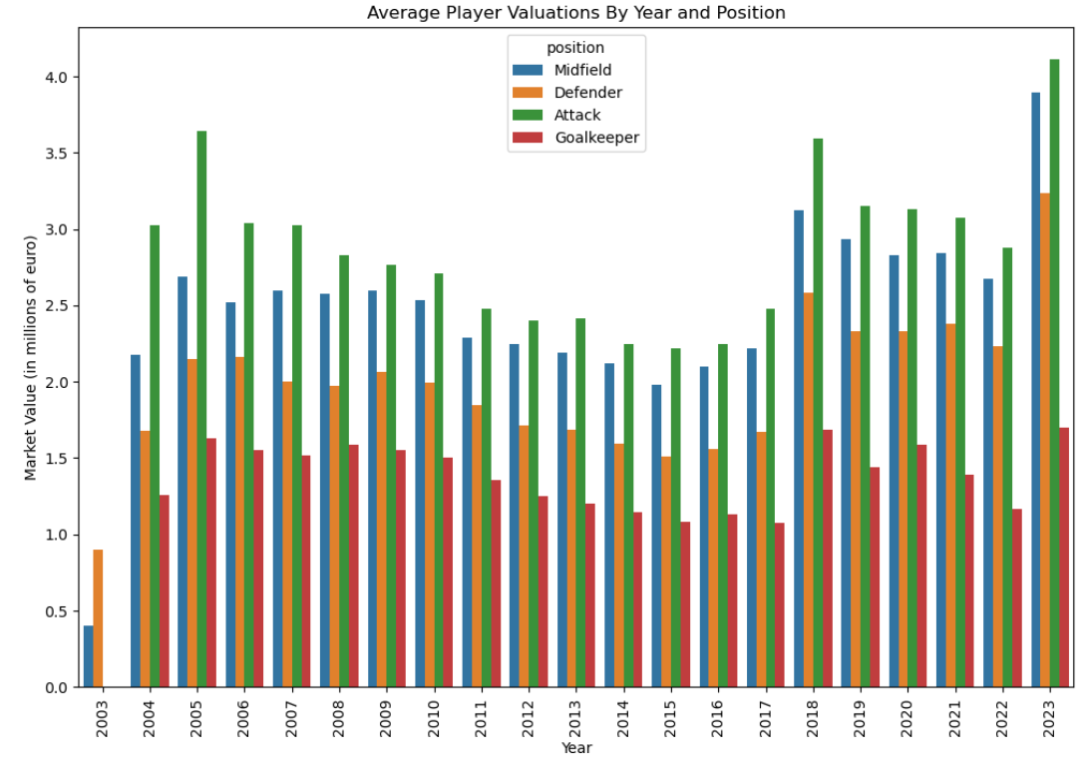
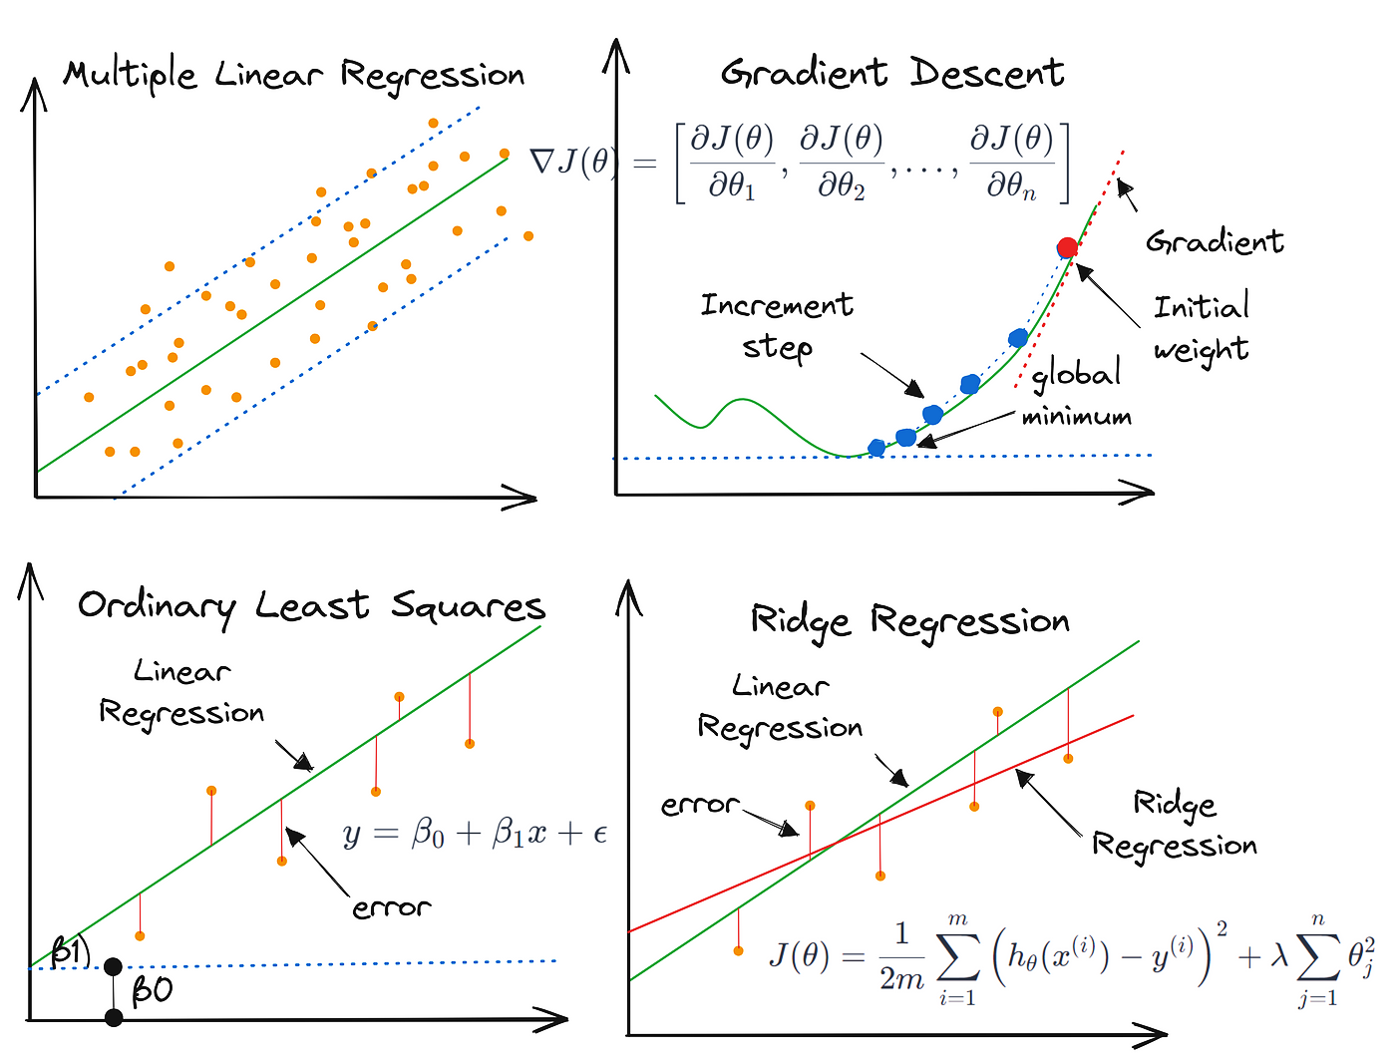
Leveraging Machine Learning and Data Science for Competitive Advantage: Estimating Football Player Market Values
Author: Kavi Patak Lecturer: James Garza
Introduction
Multivariate Analysis
LightGBM adopts a leaf-wise growth strategy, as opposed to the traditional level-wise approach. The fundamental difference lies in how the tree grows and how branches expand.
The role of analytics in football has evolved over the past decade, and will continue to do so. Technological developments continue to improve the volume and quality of data available to the world’s leading clubs, as well as the ability to derive insight from them. The opportunity exists for clubs of all sizes to use analytics to build a sustainable competitive advantage, something which will be most evident in the area where they invest most: the transfer market.
The tree grows by adding a leaf that provides the maximum gain at each expansion step. In other words, only one leaf node is added at each expansion step.
The Methodology…
Business Understanding
This initial phase focuses on understanding the project objectives and requirements from a business perspective. It involves understanding what the stakeholders want to achieve, defining the project goals, and translating these goals into Data Analytics and Machine Learning objectives.
Data Preparation
Data preparation and preprocessing is a crucial step in any Data Science project’s lifecycle. It involves several operations and transformations being applied to raw data to make it suitable for analysis and modelling.
Evaluation
This project aims to level the playing field, at least financially
in the transfer market, by developing a machine learning model
to estimate the market value of football players based on various features such as age, goals, assists and other contributing factors.
Preprocessing
After building models, they need to be evaluated to determine their performance and effectiveness. This phase involves assessing the models' performance using appropriate evaluation metrics and techniques. It may also involve comparing different models to select the best one for deployment.
The aim is to enhance the quality of the data by:
addressing missing or inconsistent values,
handling various data types including type casting,
number formatting, and label encoding categorical variables,
transforming or scaling the data using standardisation or normalisation techniques,
and conducting feature engineering.
Data Understanding
Consolidating and Characterising the Data
Merged Dataset
In this phase, we gather and understand the data required for the project. This includes identifying data sources, collecting data, and exploring its structure, validity, and content. It is an important phase in assessing whether the available data is sufficient to address the project
objectives.
Data: “Football Data from Transfermarkt” provided by Kaggle
Modelling
Available at: https://www.kaggle.com/datasets/davidcariboo/player-scores/versions/284
9 CSV Files:
appearances_df : (1485697, 13)
club_games_df : (128586, 11)
clubs_df: (426, 16)
competitions_df: (43, 10)
game_events_df: (652010, 10)
game_lineups_df : (86822, 9)
games_df : (64293, 23)
player_valuations_df : (440663, 9)
players_df: (30302, 23)
Deployment
In this phase, you build and evaluate models to address the project objectives. This could involve selecting appropriate modelling techniques, building different models, and tuning their parameters.
Exploratory Data Analytics
The objective is to predict the market value of a player, which is continuous data, making this a regression problem. As we are measuring the relationships between multiple independent variables to the target variable, it is a multiple regression problem. Furthermore, we are using labelled data making this a supervised ML application.
Once a satisfactory model is identified, it needs to be deployed into production. This phase involves implementing the model into the operational environment, integrating it with existing systems, and providing documentation and support for end-users.
EDA is a process of examining the available data to discover patterns of correlation, identify trends, and gain insights of interest. It aids in spotting anomalies, testing hypotheses and clarifying any assumptions.
We find that the target variable data, ‘Market Value’, is right skewed, and requires a log transformation for normal distribution. The data also contains multiple outliers identifiable through the box plot below.
Through EDA we discover similar patterns and irregularities within the independent variables used for predicting. These findings will influence preprocessing decisions and techniques applied in Machine Learning.
Conclusion
Bivariate Analysis
The CRISP-DM methodology is iterative, meaning that it often requires going back and forth between different phases as new insights are gained or requirements change. For example, if the evaluation phase reveals that the model performance is not satisfactory, you may need to revisit the data preparation or modelling phases to make improvements.
Tools...
References…

Slide 5
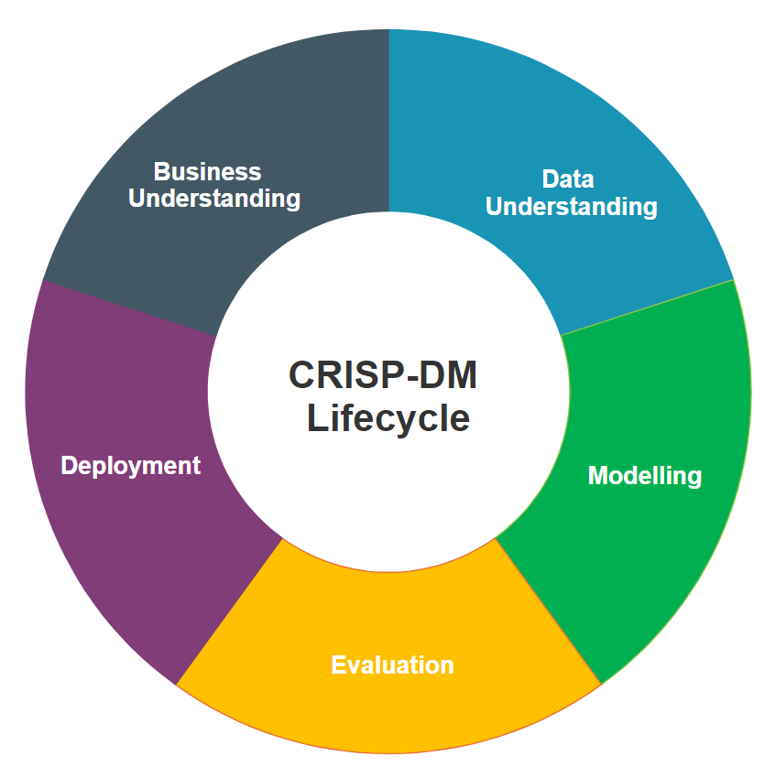
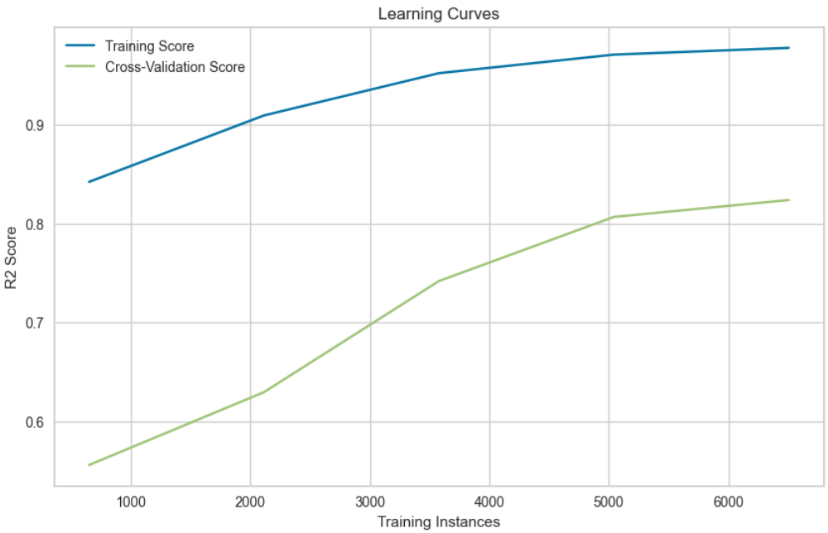
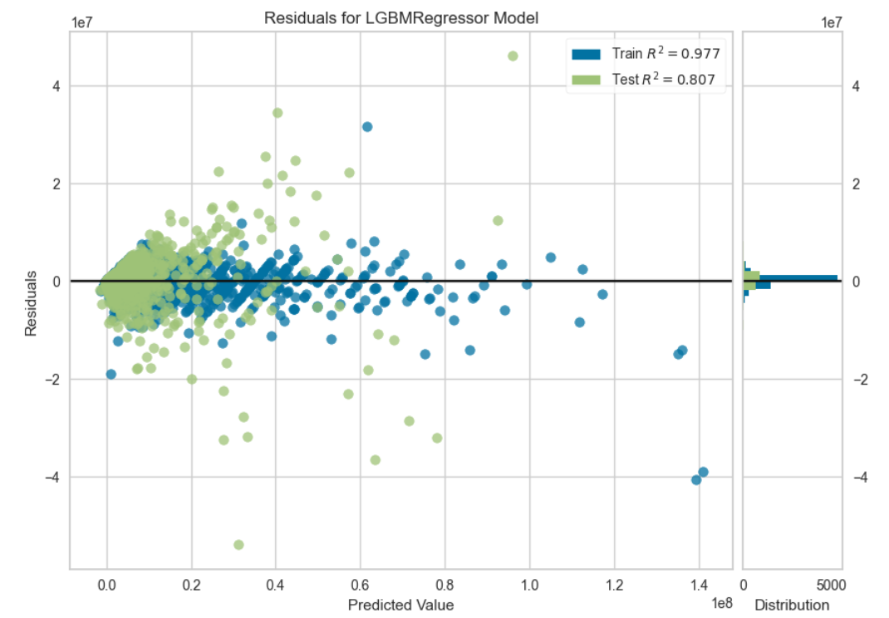
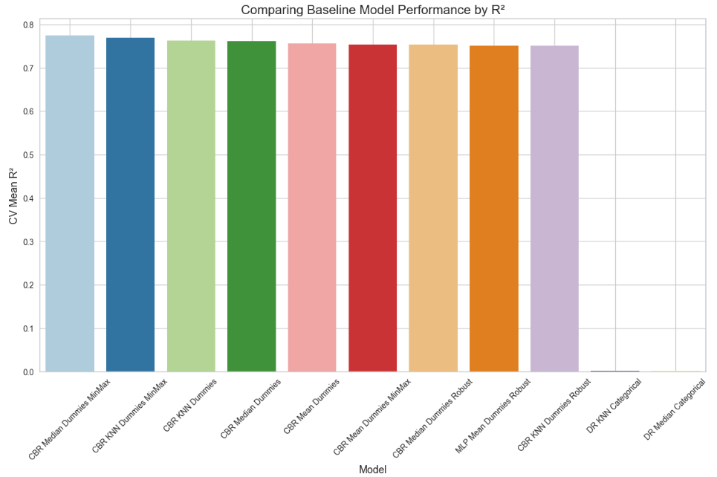
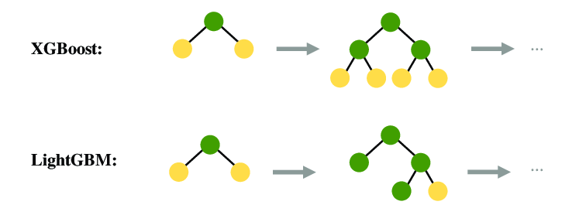
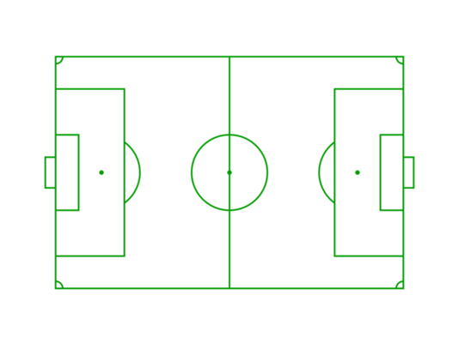


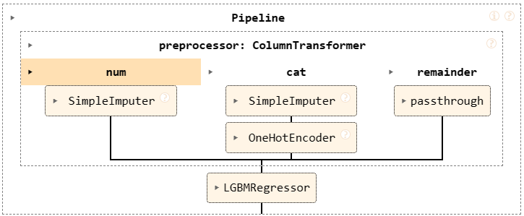
Leveraging Machine Learning and Data Science for Competitive Advantage: Estimating Player Market Values
By Kavi Patak
Introduction
The role of analytics in football has evolved over the past decade, and will continue to do so. Technological developments continue to improve the volume and quality of data available to the world’s leading clubs, as well as the ability to derive insight from them. The opportunity exists for clubs of all sizes to use analytics to build a sustainable competitive advantage, something which will be most evident in the area where they invest most: the transfer market.
The Process…
Business Understanding
The role of analytics in football has evolved over the past decade, and will continue to do so. Technological developments continue to improve the volume and quality of data available to the world’s leading clubs, as well as the ability to derive insight from them. The opportunity exists for clubs of all sizes to use analytics to build a sustainable competitive advantage, something which will be most evident in the area where they invest most: the transfer market.
Evaluation
Data Understanding
Modelling
The role of analytics in football has evolved over the past decade, and will continue to do so. Technological developments continue to improve the volume and quality of data available to the world’s leading clubs, as well as the ability to derive insight from them. The opportunity exists for clubs of all sizes to use analytics to build a sustainable competitive advantage, something which will be most evident in the area where they invest most: the transfer market.
The role of analytics in football has evolved over the past decade, and will continue to do so. Technological developments continue to improve the volume and quality of data available to the world’s leading clubs, as well as the ability to derive insight from them. The opportunity exists for clubs of all sizes to use analytics to build a sustainable competitive advantage, something which will be most evident in the area where they invest most: the transfer market.
Deployment
This usually results in deeper but narrower trees. Deeper trees can offer more flexibility to capture complex feature relationships.
It is generally faster compared to the level-wise approach.

Slide 6
